Slide 1
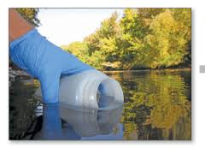
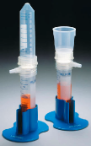
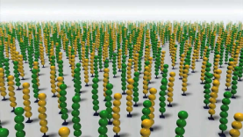
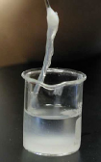
collect sample
Filter and concentrate Virus-like particles
Next-Gen Sequencing
Extract and concentrate all
DNA

Slide 2
$Time
$40/sample
Kit from EMD Millipore
$500/sample
3 providers from Science Exchange
$50/sample
3 providers from Science Exchange

Slide 3
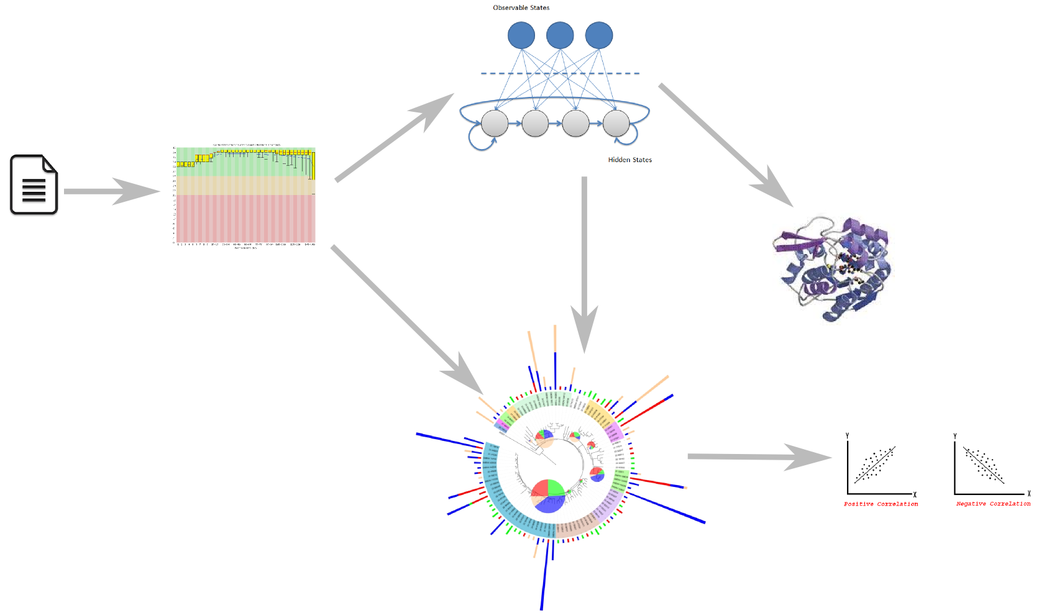
Find Genes
Quality Control
New functions
Reads
Phylogenetics &
similar analyses
Correlate environmental conditions with microbes/viruses

Slide 4
MetaGene
ORFfinder
QTrim
Trimmomatic
MetaPhlan
MetaVelvet
MetaBAT

